Slide 1

Basic course9-LED matrix static show
Yahboom
Yahboom OMIBOX Tutorial

Slide 2
1
2
3
4
5
Learning
goals
Search for
blocks
Combine
blocks
Experimental
phenomena
Preparation
程序编程
Tencent
Yahboom OMIBOX Tutorial

Slide 3
1
Preparation-1
1. The position of the LED matrix in the robot car
2. Learn how to control LED matrix of robot car by graphically programming
Yahboom OMIBOX Tutorial

Slide 4
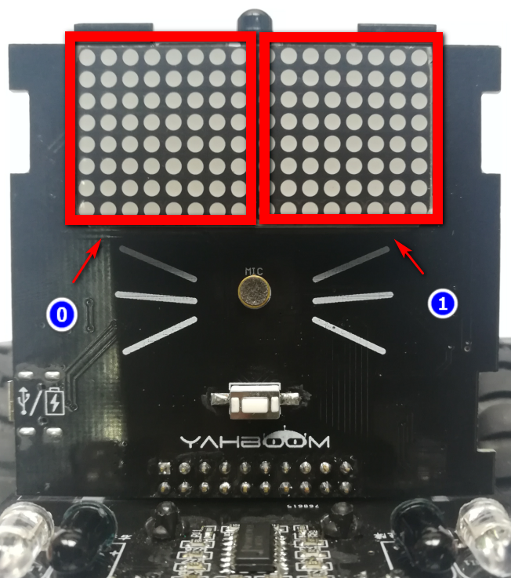
1
Preparation-2
As shown in the above figure, the LED matrix of the Omibox robot consists of two dot matrixes, the No1 LED matrix on the left and the No2 LED matrix on the right.
Yahboom OMIBOX Tutorial

Slide 5
2
Learning goals
In this lesson, we will learn to how use LED matrix blocks and control the display static picture on the LED matrix screen.
Yahboom OMIBOX Tutorial

Slide 6
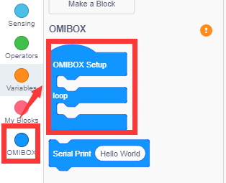
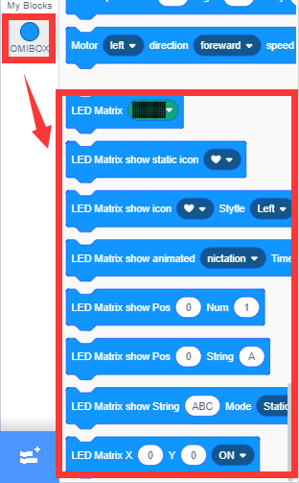
3
Search for blocks
The following is the location of the building blocks required for this programming.
Yahboom OMIBOX Tutorial

Slide 7
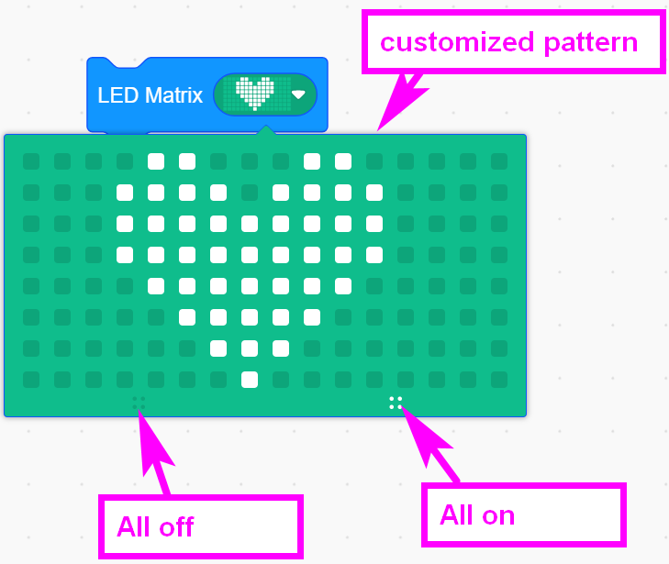
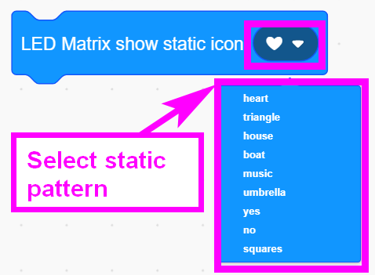
3
Search for blocks
Yahboom OMIBOX Tutorial

Slide 8
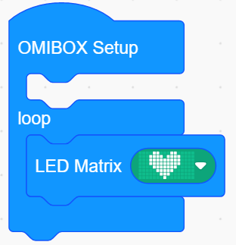
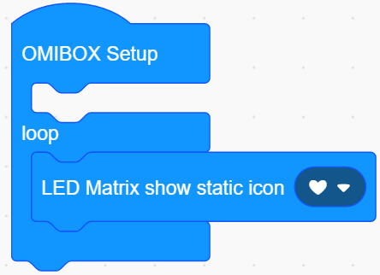
4
Combine blocks
The summary program is shown below:
Method1：
Method2：
Yahboom OMIBOX Tutorial

Slide 9
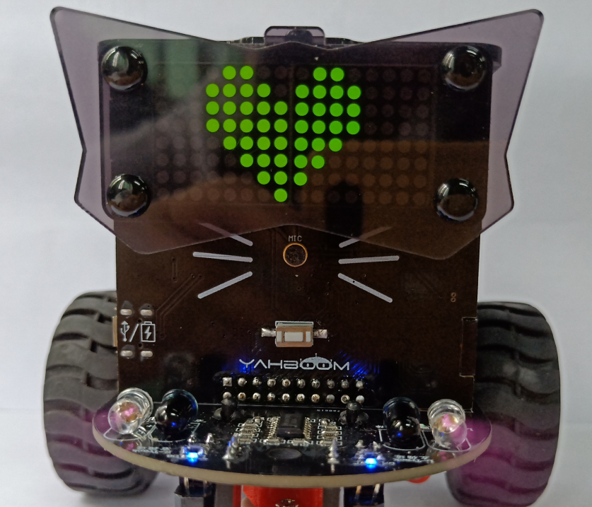
5
Experimental phenomena
After the program is uploaded, open the power of the robot car, a heart will be displayed on the LED matrix, as shown in the figure below.
Yahboom OMIBOX Tutorial

Slide 10
Inspire Creativity Embrace Innovation
Thank you!!!
Yahboom

